Slide 1
MULTI REQUEST ROUTE PLANNING USING ONE WAY SEARCH
Dasari Charan Srinivas Reddy -242IT007
Konduru Sai Kiran -242IT014
Kunduru Phaneendra Reddy -242IT016
Nandam Sai Saketh -242IT021

Slide 2
PROBLEM STATEMENT
Given a set of user and service requests each specifying a desired destination, find the optimal route that efficiently serves all requests while minimizing travel distance or time.
OBJECTIVES
Working with a real-world dataset from NITK college, identifying multiple points of interest, and calculating the distances between neighbouring nodes.
Develop the algorithm to get most efficient using Greedy, branch and bound and Backtracking.
Evaluate the performance of the proposed algorithm and demonstrate it with Maps API.

Slide 3
METHODOLOGY
OWS first searches a route on the basis of the POIs that provide at least one unsolved user request and pass three pruning mechanisms.
One of them is greedily selected for path expansion and route update to rapidly identify a more favorable route.
OWS involves three pruning mechanisms named Filter, Potential, and Petrifaction mechanisms and three operations named Wilting, Selection, and Reverse Update to avoid unnecessary searches and thus improve search efficiency.

Slide 4
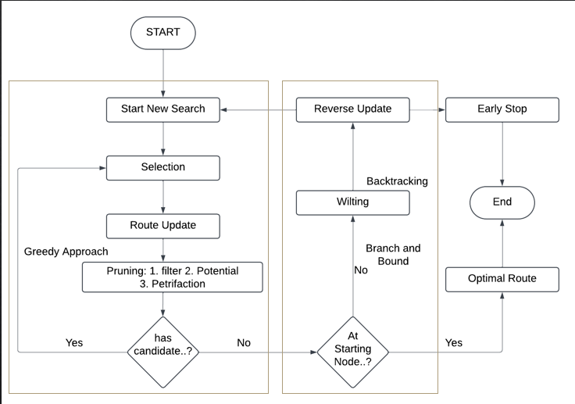
FLOW CHART

Slide 5

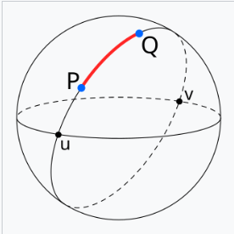
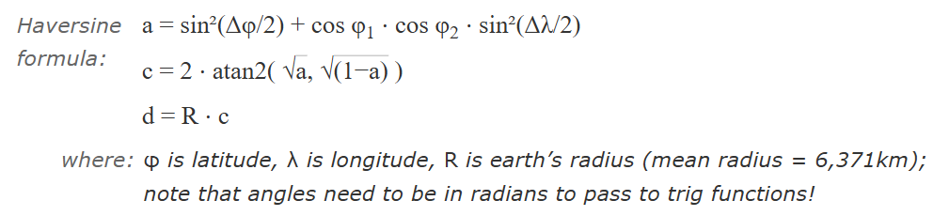
Data Points Visualization
1, 13.010929, 74.792304, IT Dept
2, 13.011546, 74.79232, ECE Dept
3, 13.0107528,74.7920782, LHCC
4, 13.010026,74.7922319, Parking lot
Distance Calculation:

Slide 6
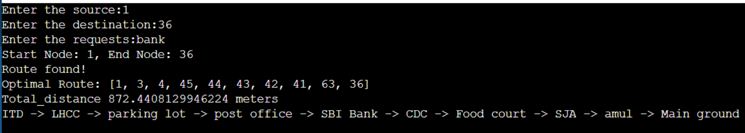
Intermediate Results
Shortest path between the source and the destination using OWS algorithm.

Slide 7
Time and Space Complexity
Node and Graph Initialization
Time Complexity:O(N+E), where N is the number of nodes and E is the number of edges
Space Complexity: O(N+E)
For pruning and reverse update the time and space complexity is O(1)
OWS Algorithm
Time Complexity: O(N+E+V×N)
Space Complexity: O(N+E).

